Slide 1
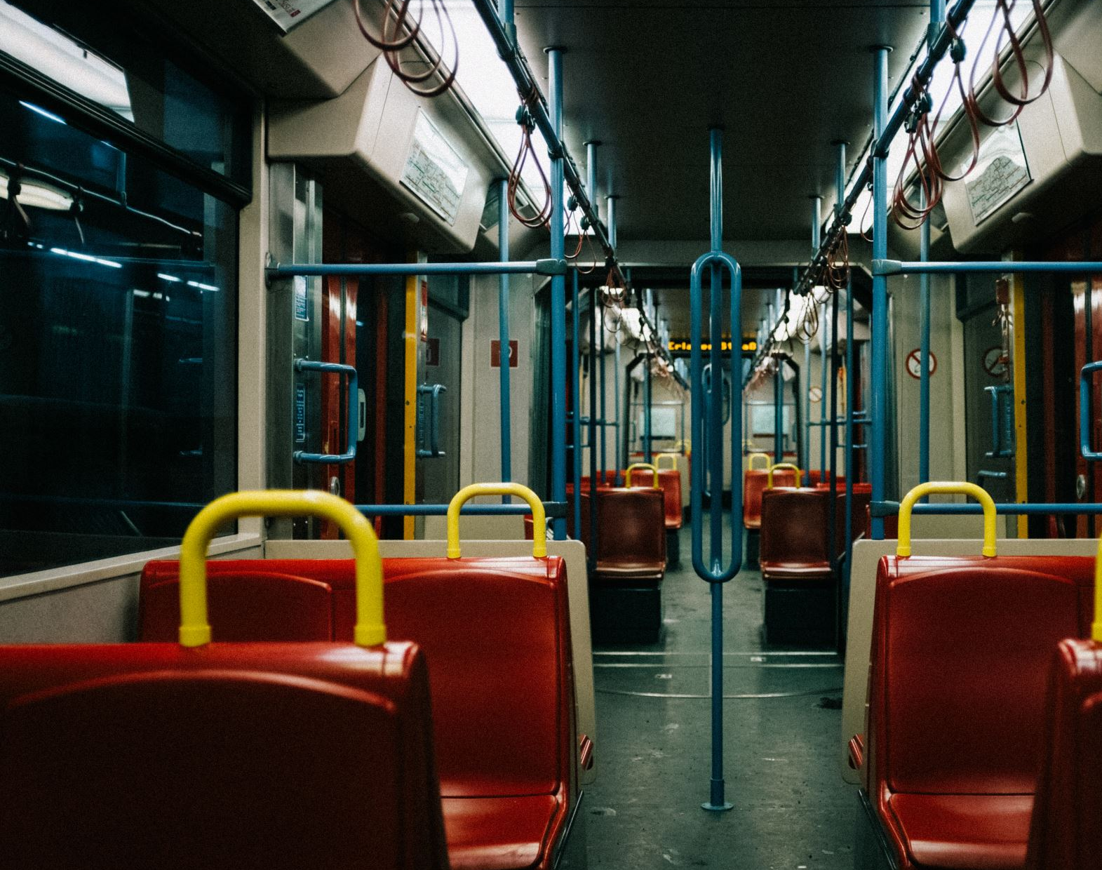
Transit Usage in Pittsburgh, Pennsylvania
By Colton Lapp
April 28th, 2023

Slide 2
Intro
The pandemic led to reduced travel patterns and decreased ridership rates in public transit systems across the country.
Pittsburgh, Pennsylvania experienced persistently low ridership rates even after the lifting of lockdown restrictions.
The project aims to analyze geospatial data to better understand the current and historical patterns of transit usage in Pittsburgh and how it has been changing since the pandemic, in order to allocate public funding more efficiently.

Slide 3
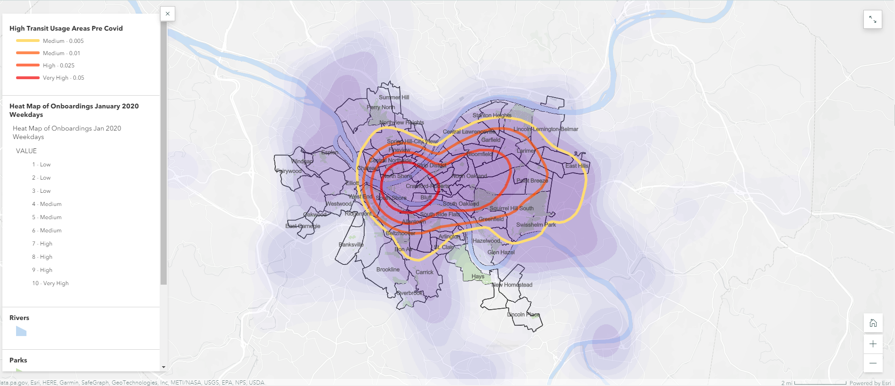
Usage before Covid
The Central Business District and neighborhoods around major universities had the highest usage levels for public transit before the pandemic in Pittsburgh, as shown by contours drawn on a heatmap.

Slide 4
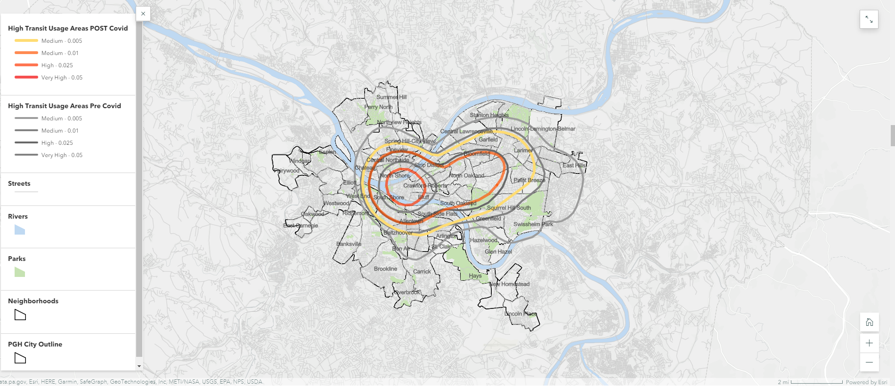
How did geospatial distribution of ridership change after Covid? Comparing onboarding data from January 2020 to April 2021 shows a decline in overall ridership across the city of Pittsburgh, with no neighborhoods reaching the highest usage level seen in 2020, but the geospatial distribution of ridership remains broadly similar.

Slide 5
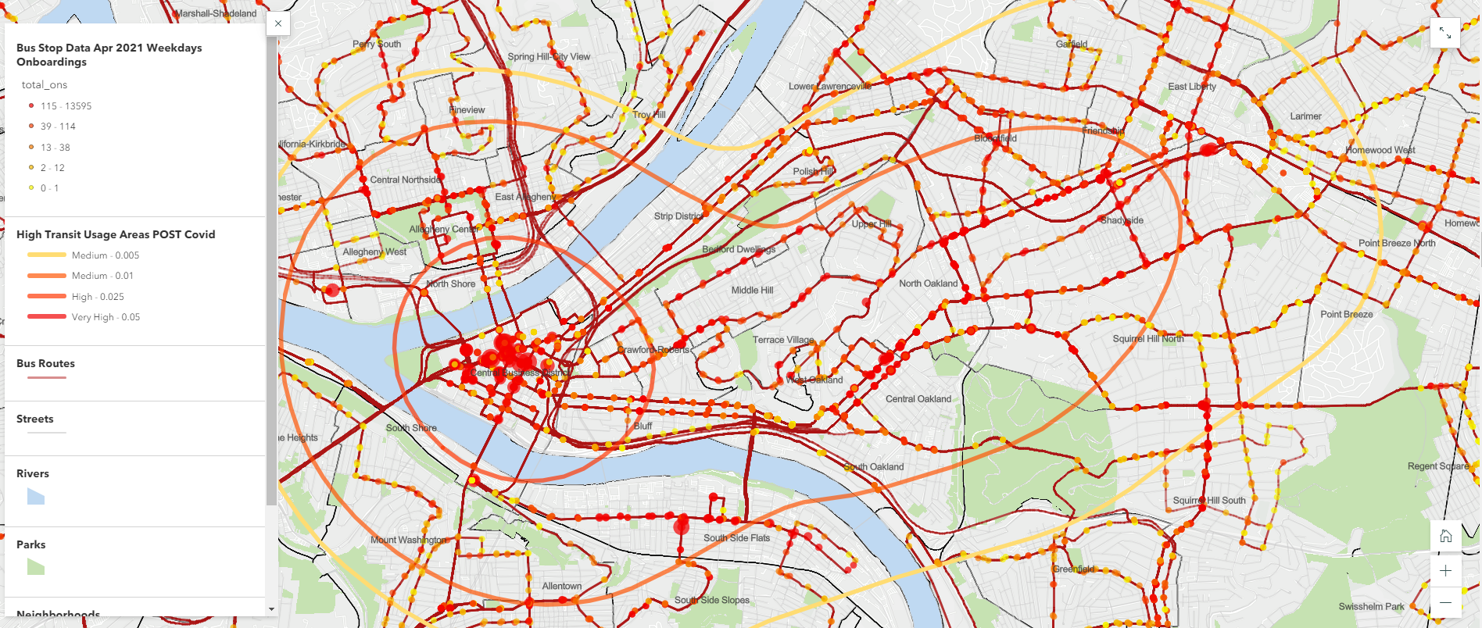
Map showing high use contours, bus stop, and route data in Pittsburgh The map highlights high concentration of bus stops with exceptionally high onboardings in the Central Business District and certain streets, while many routes on the outskirts of Allegheny County have low usage levels.

Slide 6
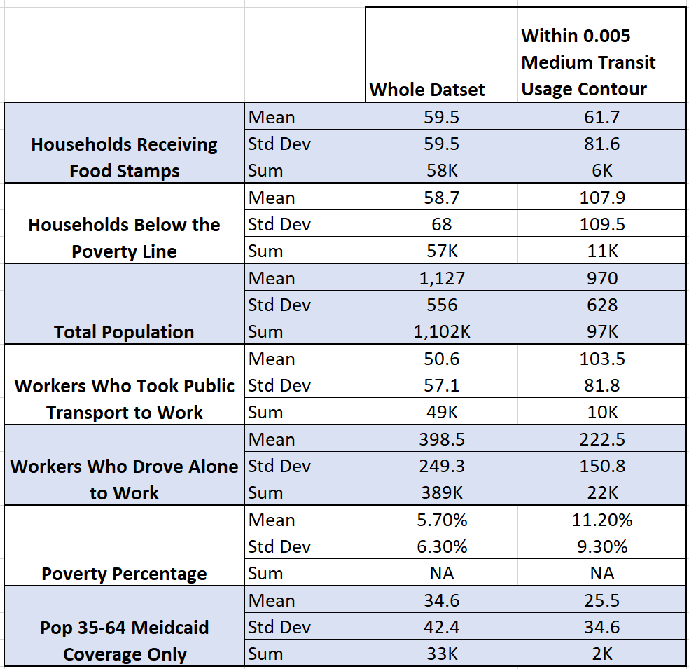
Summary Stats Comparing High Transit Usage Area vs Allegheny County
The high transit use area in Pittsburgh has more variation and is more heterogenous than the broader Allegheny County, according to Mean, Standard Deviation, and Sum calculations of ACS data on the Block Group Level.
Less than 10% of the total Allegheny County population lives within the high transit usage area, but around 20% of all workers who take public transit to work and 20% of all impoverished residents of Allegheny County live there. Also, around 6% of all workers who drive alone to work live in the high transit usage area, which indicates the need for public transit services in the area.

Slide 7
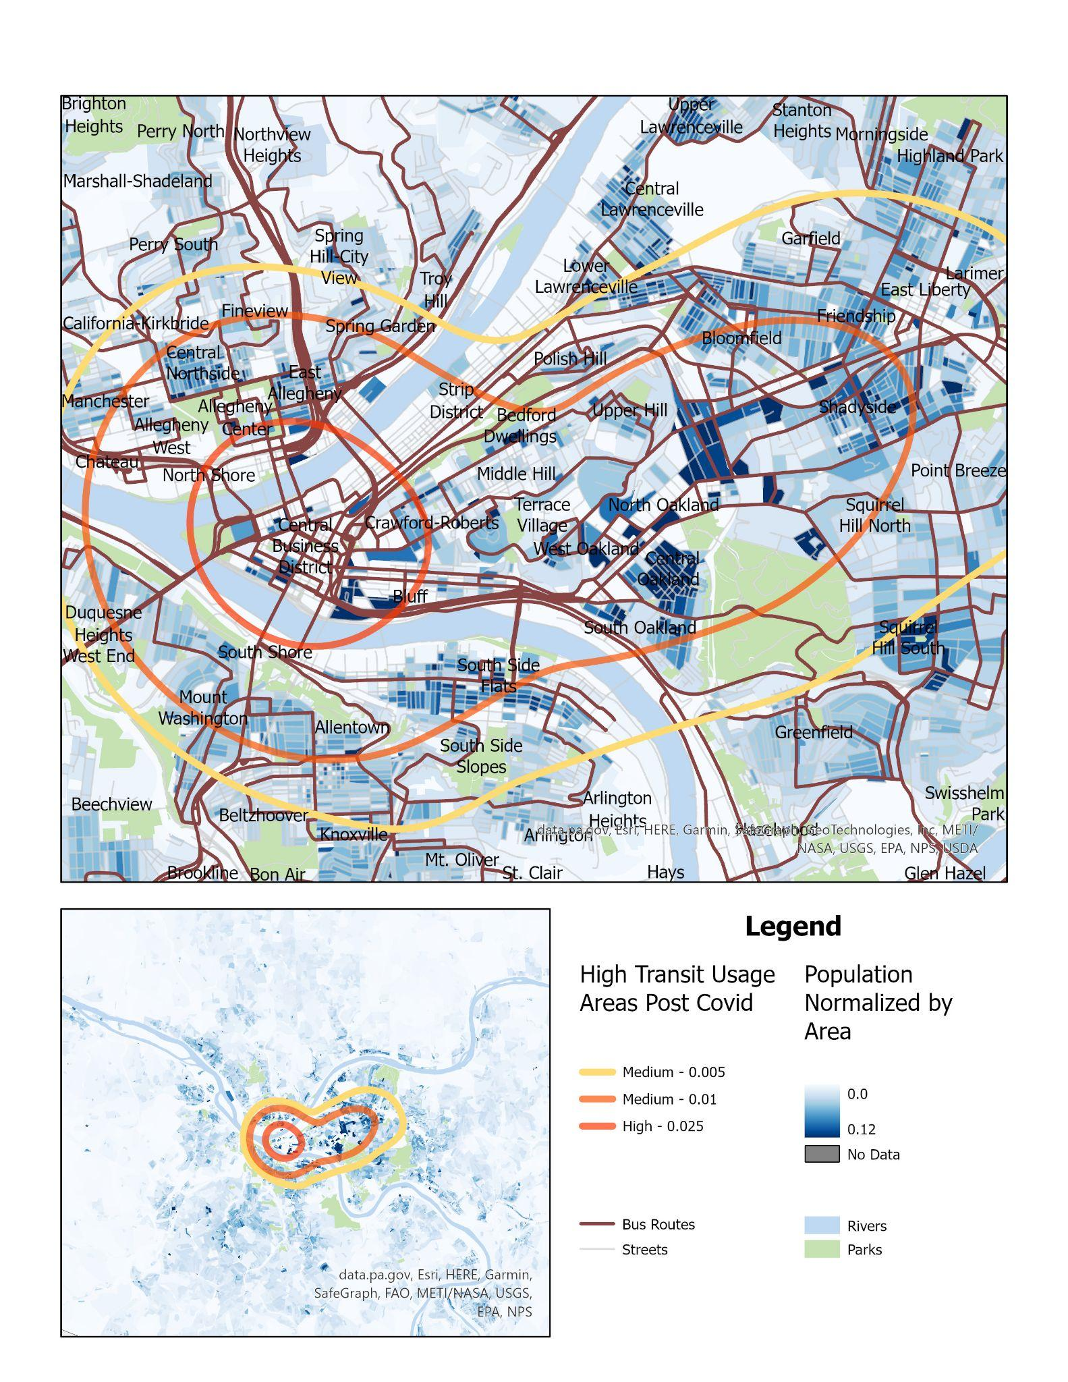
Comparing Population Density to High Transit Use Areas
Population density is not the only factor explaining high transit usage areas
the Central Business District is not particularly dense compared to other blocks, suggesting that employment rather than residential purposes may be the primary driver of transit usage in that area

Slide 8
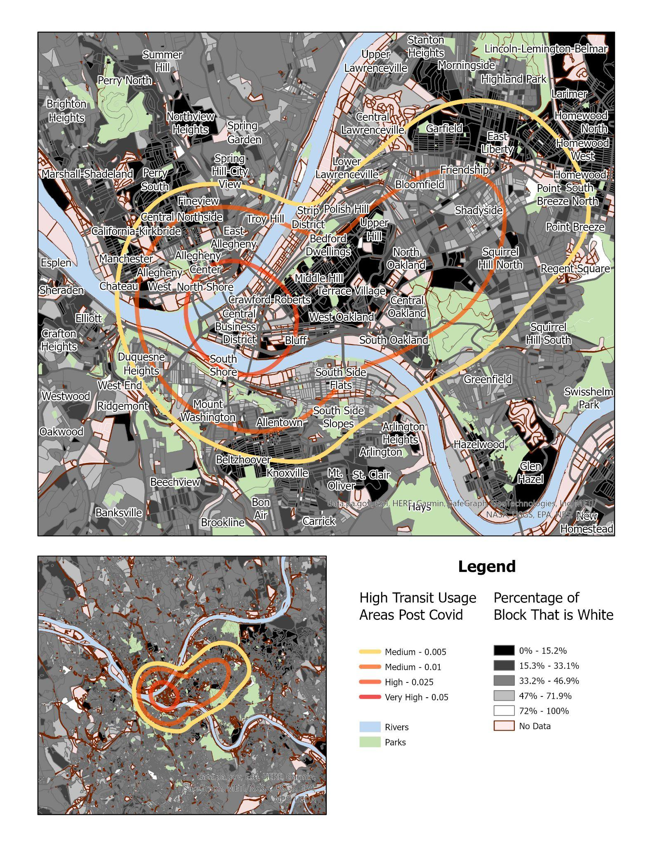
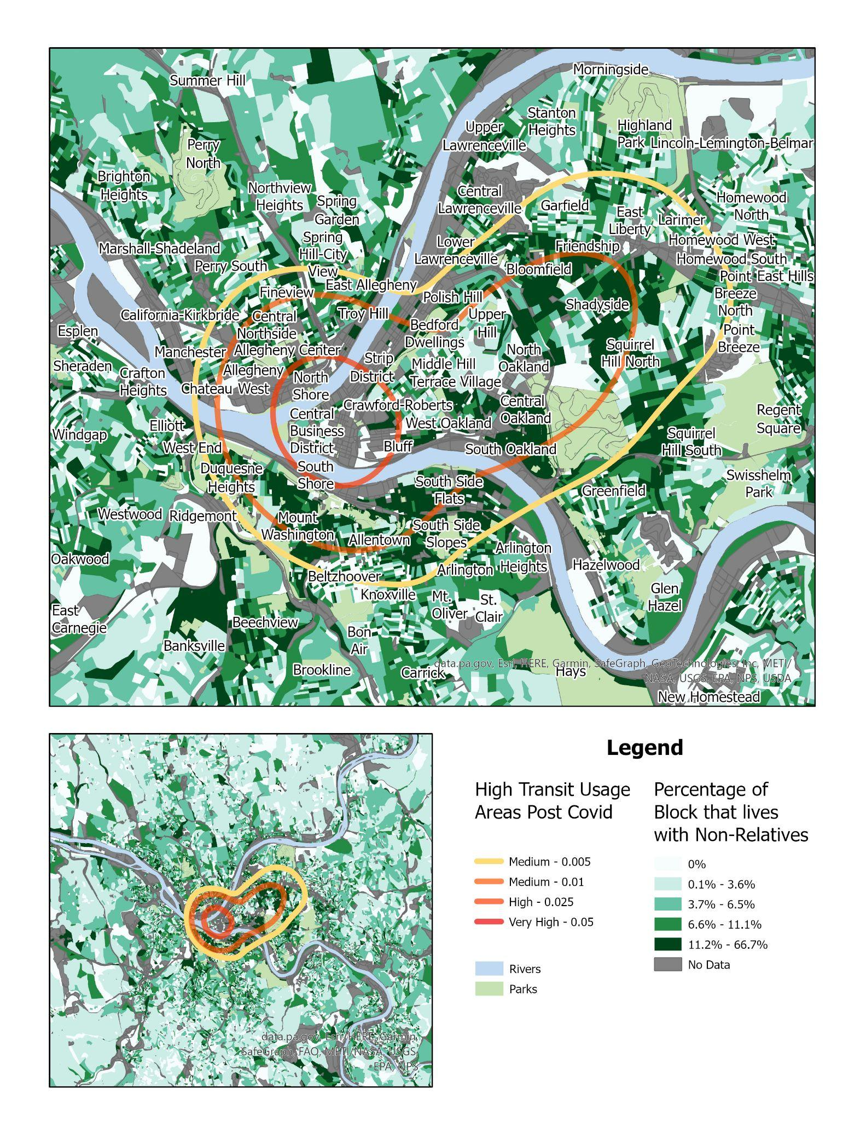
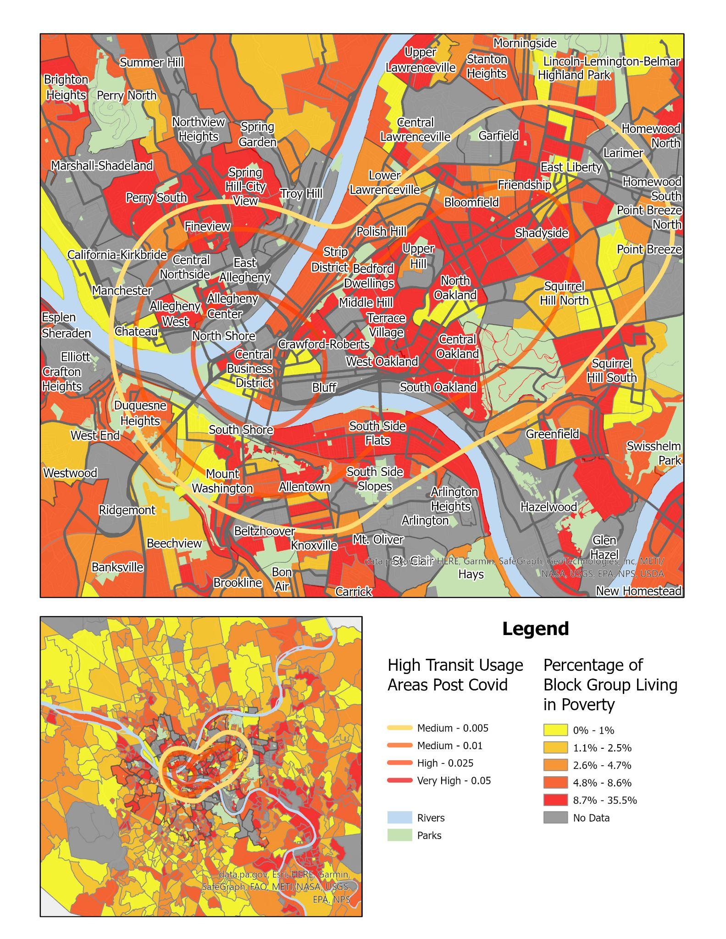
Additional Comparisons to Transit Usage Race, Living with Non-Relatives, and Poverty

